Slide 1
Android Final Project Ray’s Happy Friends
Back here again (Group 18)

Slide 2
Team Members
The game tester P78071086 高士舜
- helps us debugging
The game designerQ56051079 顏宏宇
- gives us the origin concept to create this game
The programmer
Q56071029 鄭力瑋
P76071470 楊奕正
P76071226 姚凱勛

Slide 3
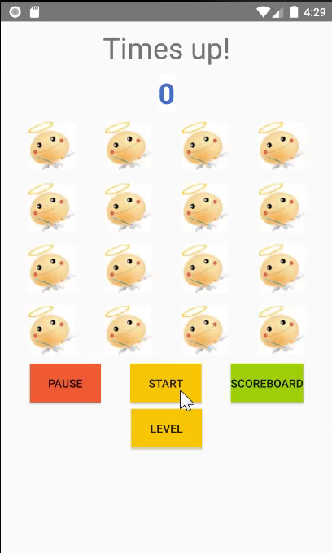
Game introduction
Button
START(<->STOP)
PAUSE(<->CONTINUE)
LEVEL
SCOREBOARD

Slide 4
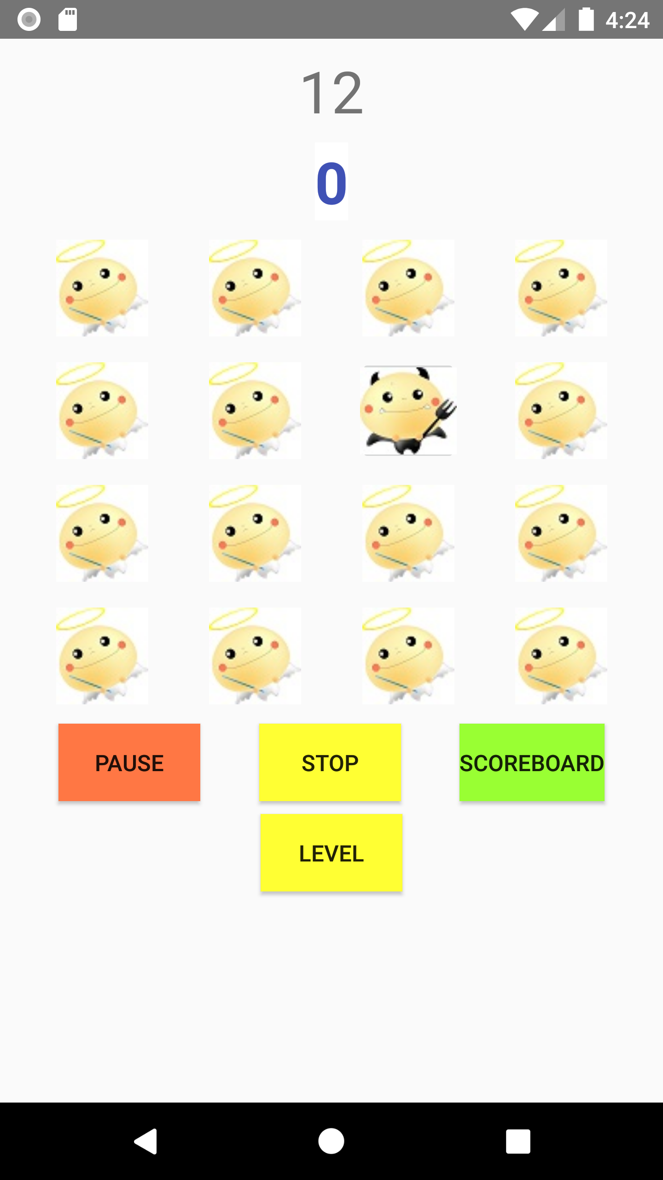
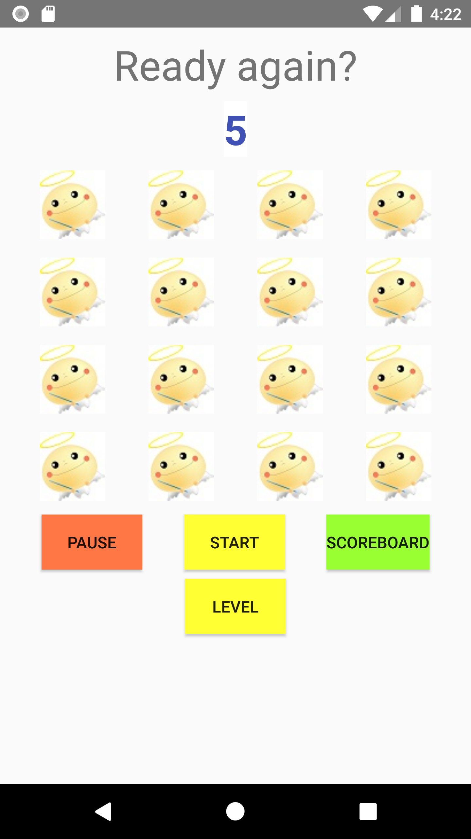
Game introduction
START
Push start button to start this amazing game.
During the game playing, you can push STOP button to reset or stop at any time.
STOP
Reset the game and the app will show the scoreboard.
Button.START
Button.STOP

Slide 5

Game introduction
Pause
It’s available to pause the game at any time when you are emergent.
Continue
Once you are free to play, you can always push continue to resume the game.
Button.PAUSE
Button.CONTINUE

Slide 6
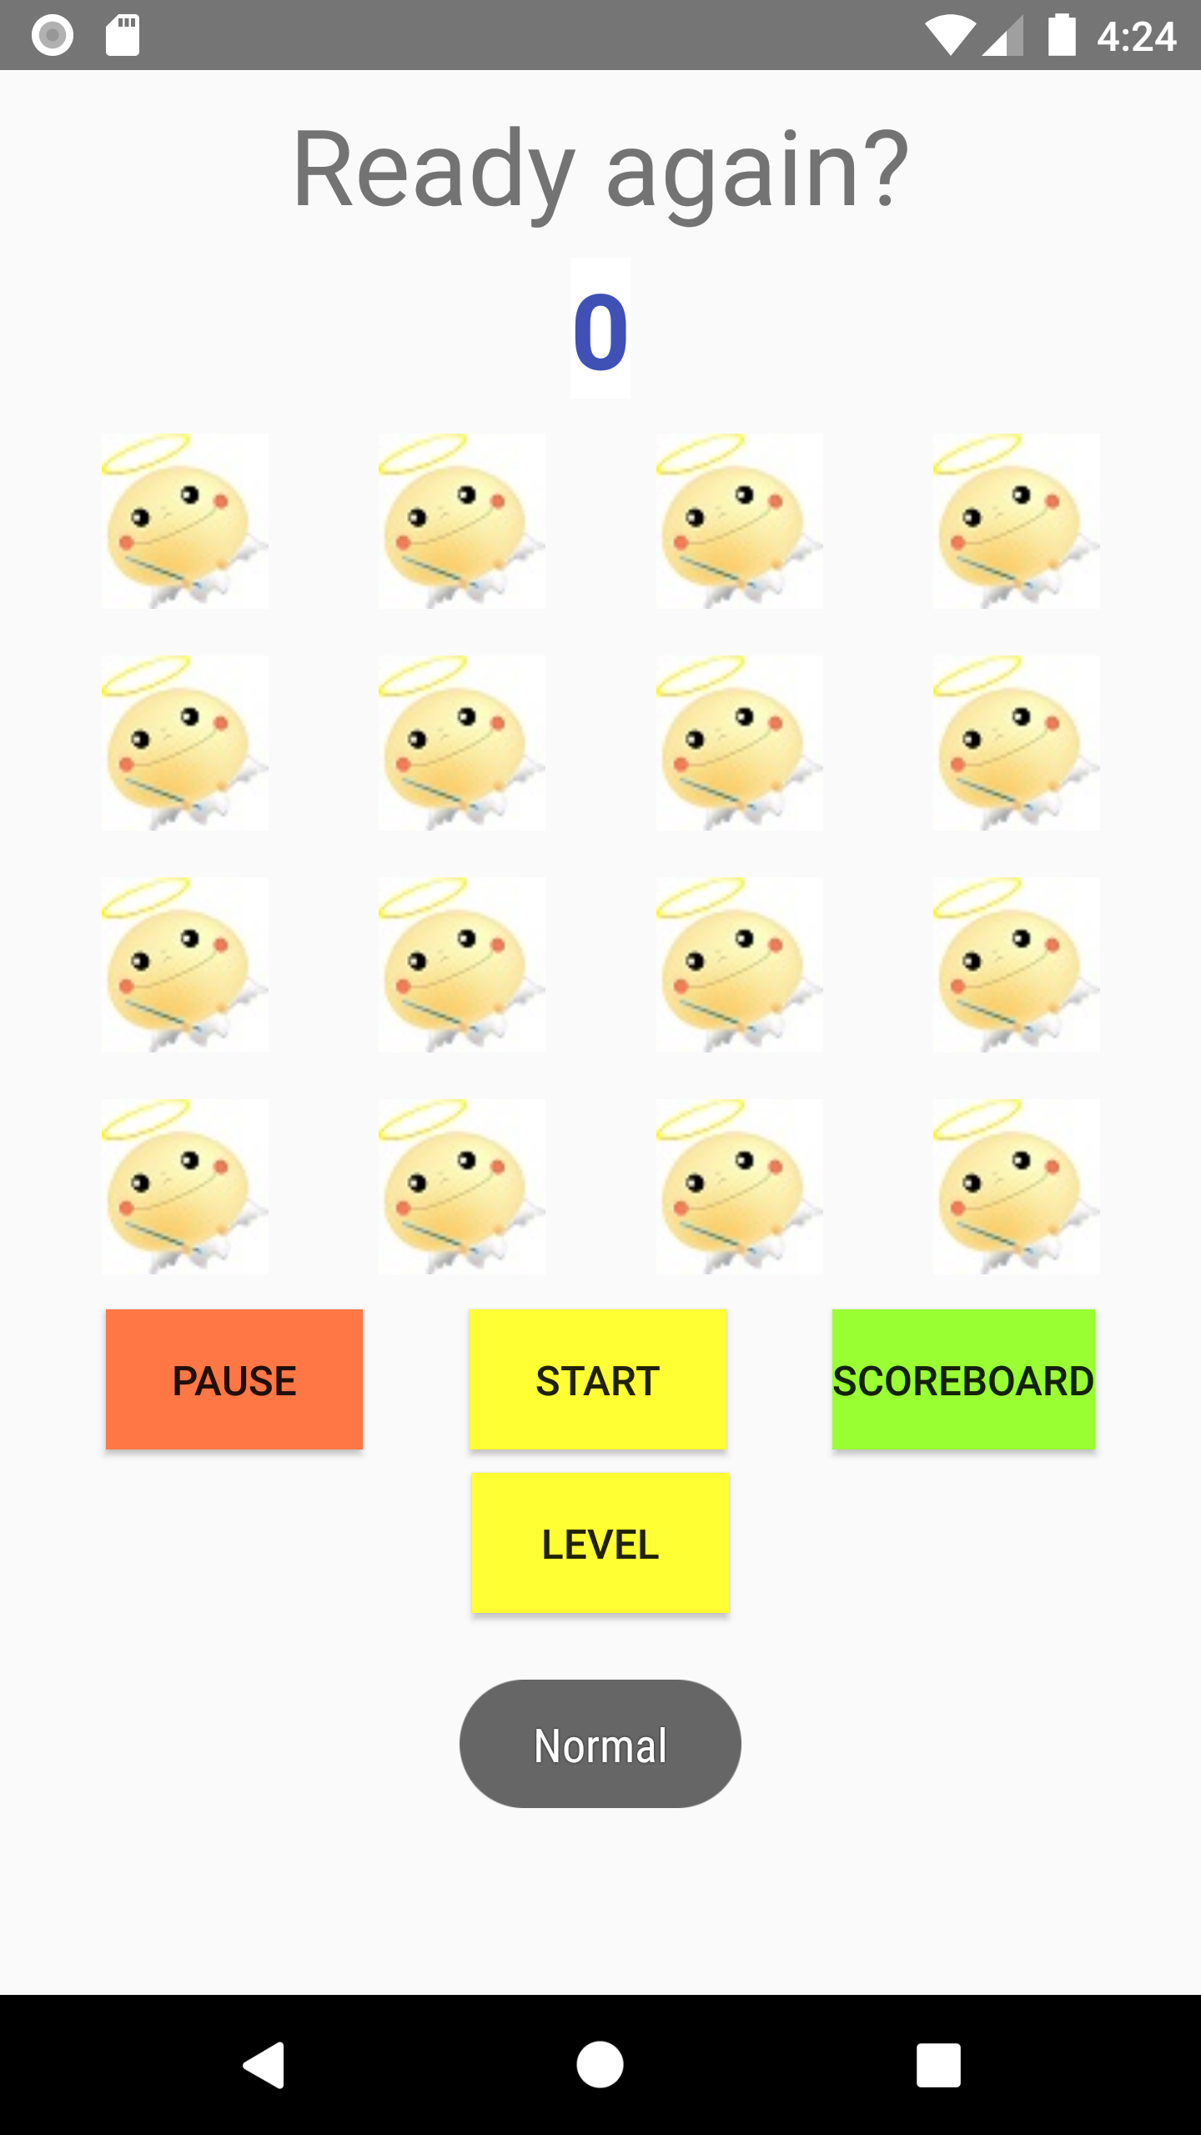
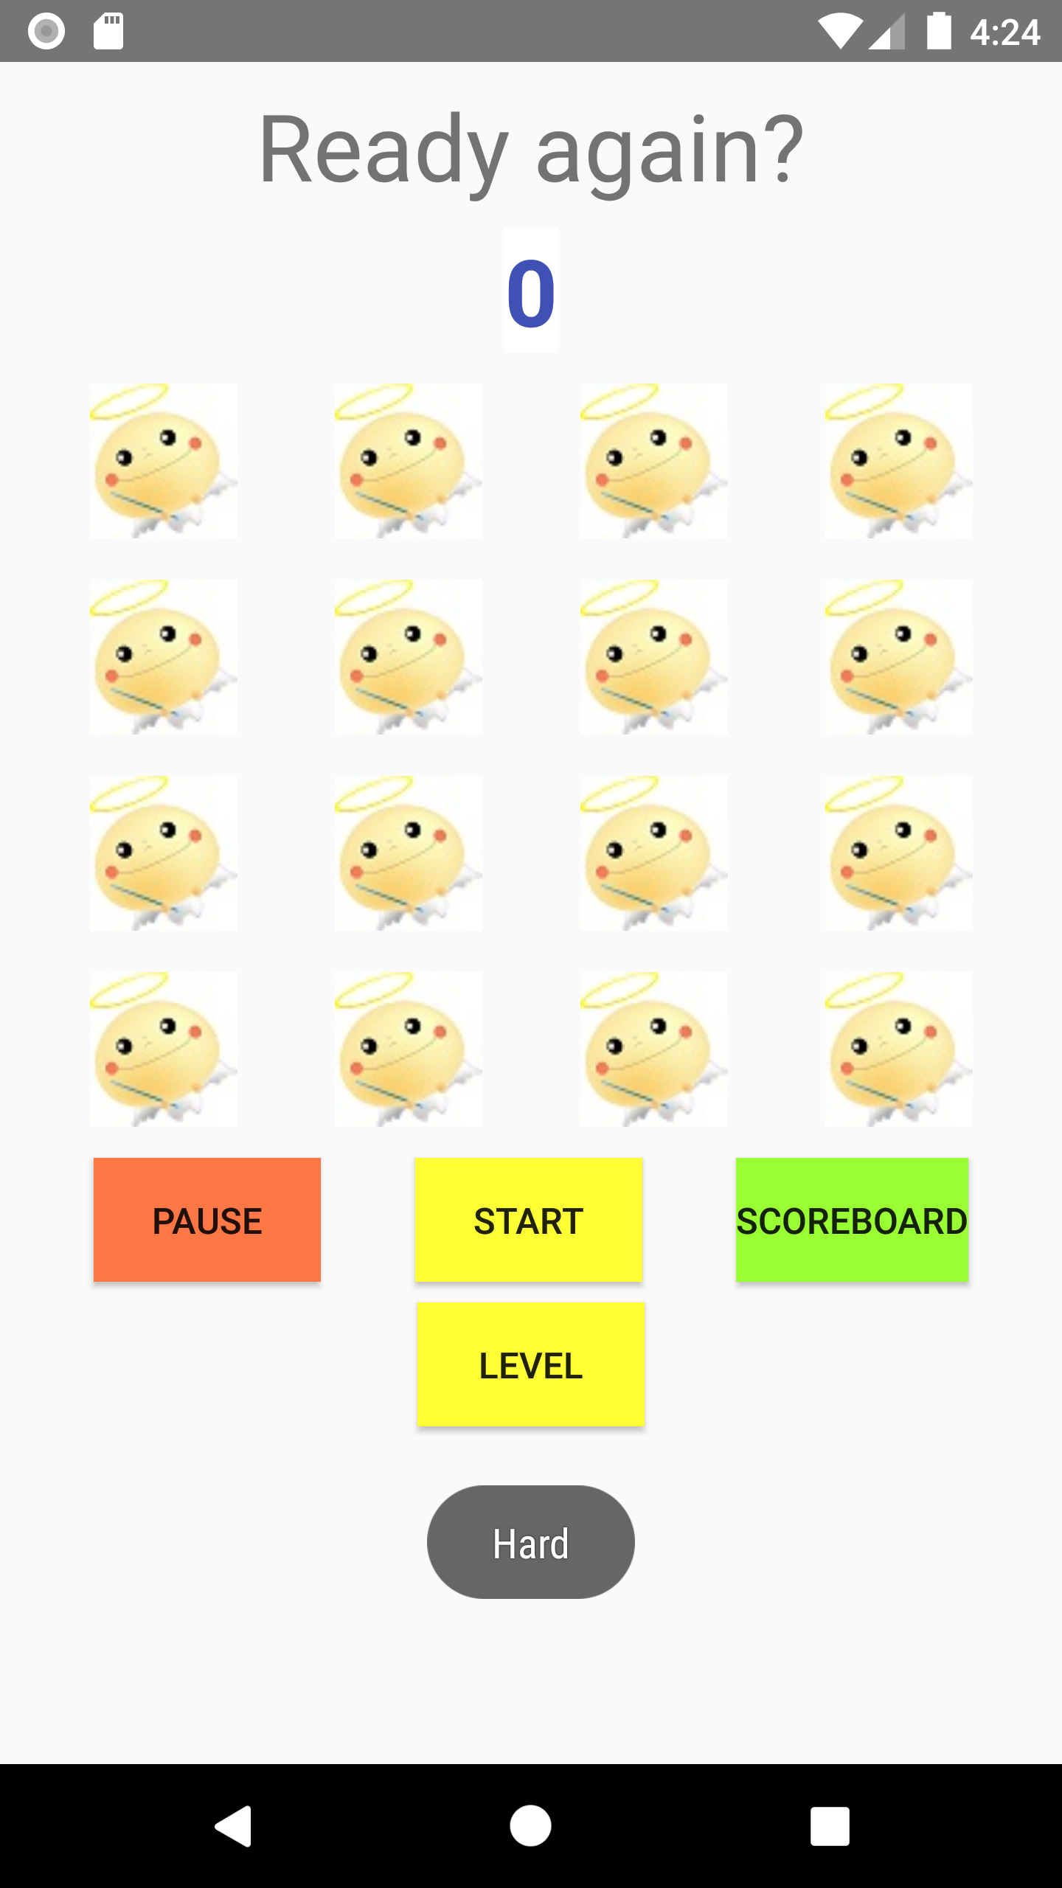
Game introduction
Level
There are two mode, normal and hard, you can switch to hard mode to get challenging experience.
Button.LEVEL

Slide 7
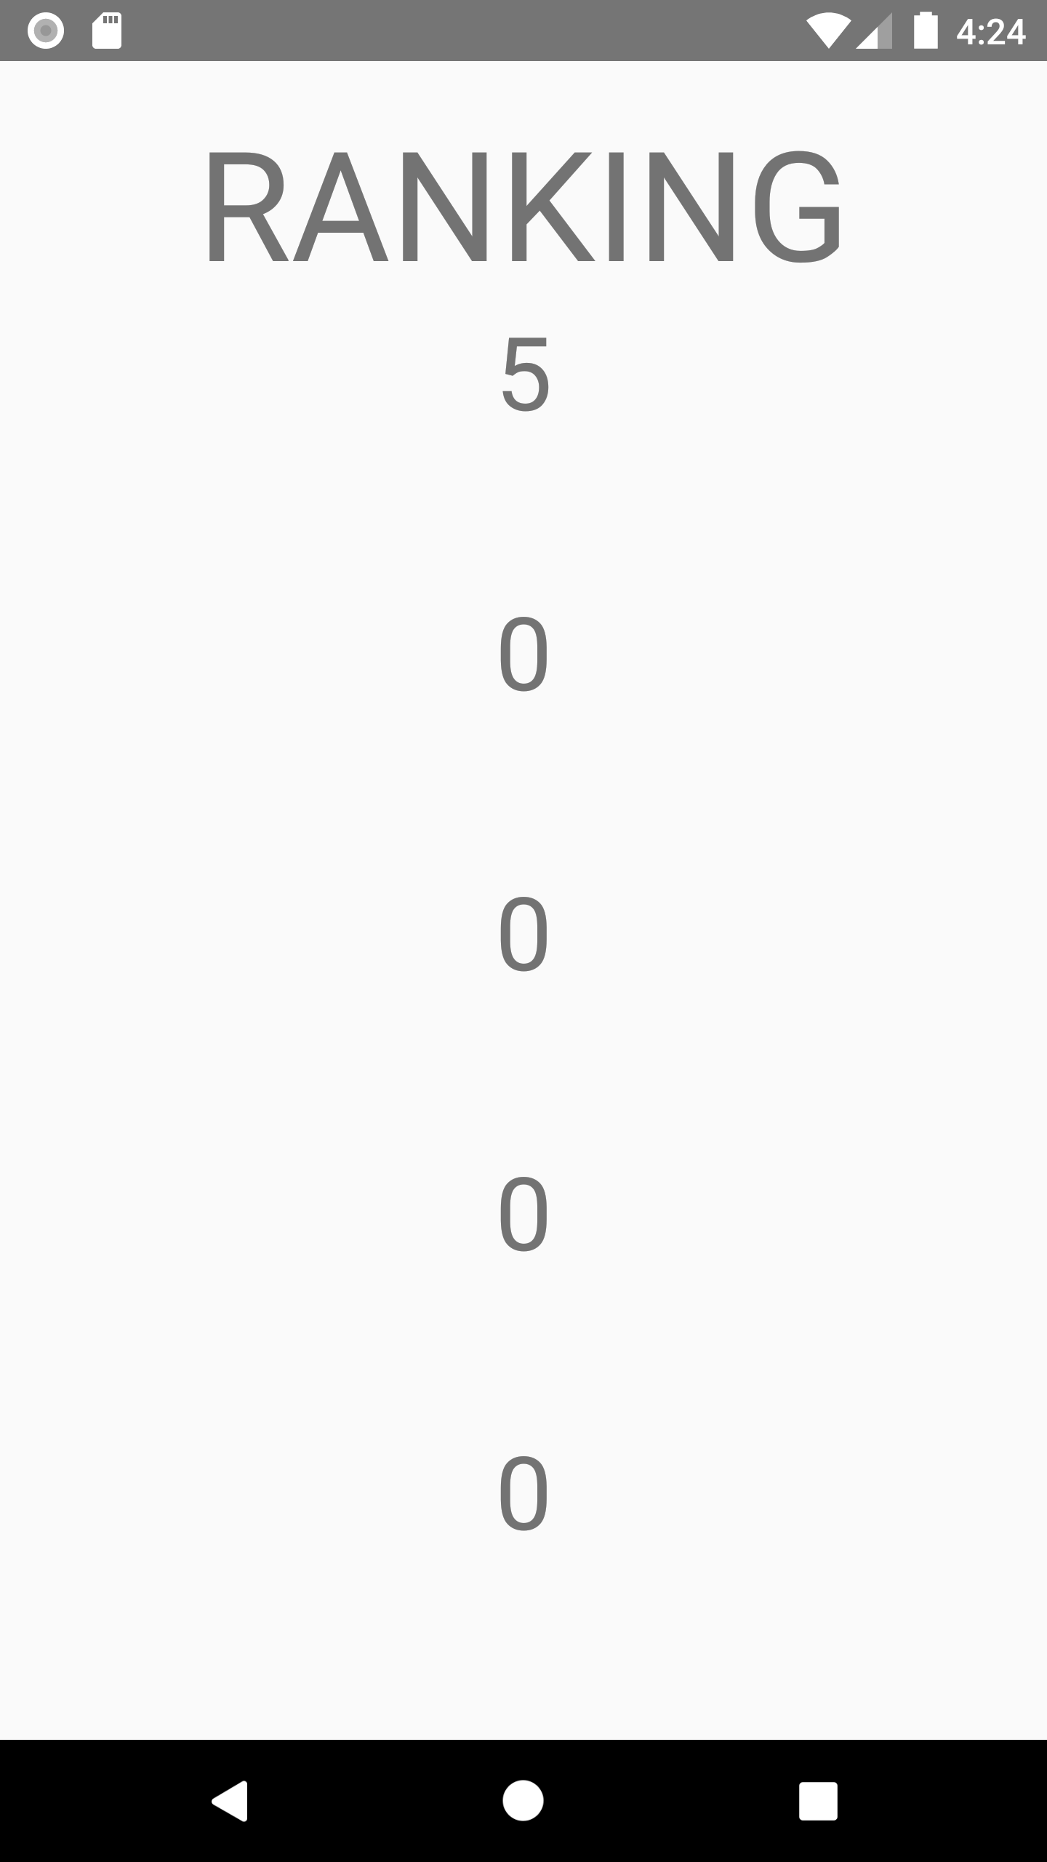
Game introduction
Scoreboard
All the score you play will be stored.
Only the top 5 will show on the ranking list.
Button.SCOREBOARD

